Slide 1



FINAL PRESENTATION
Mentor: Tran Duy Tan
Intern: Dao Thi Huong Giang

Slide 2


CONTENT
What is software testing ?
7 princiles of testing
Software Development Life Cycle
Agile Model
Software Testing Levels
What is testcase ?
Type of test design techniqes
Project overview
2

Slide 3


SOFTWARE TESTING
What is sofware testing ?
3

Slide 4
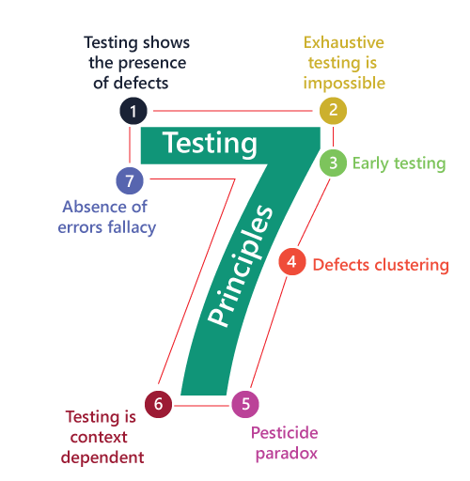

SOFTWARE TESTING
7 PRINCIPLES OF TESTING
4

Slide 5
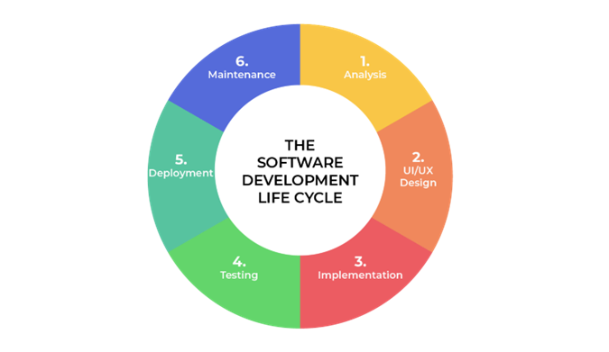
WHAT IS SOFTWARE DEVELOPMENT LIFE CYCLE ?
Software Development Life Cycle
5

Slide 6
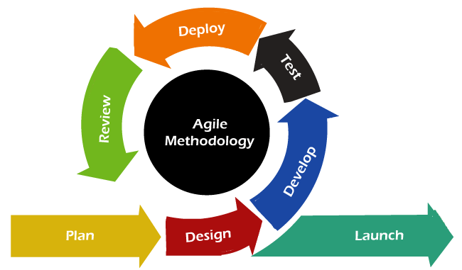
AGILE MODEL
6

Slide 7

SOFTWARE TESTING LEVELS
1
Unit test
2
Integration Test
3
System Test
4
Acceptance Test
7

Slide 8

WHAT IS TESTCASE ?
8

Slide 9

TYPES OF TEST DESIGN TECHNIQUES
Test Design Techniques are divided in to two categories:
Static testing technique.
Dynamic testing technique.
9

Slide 10
STATIC TESTING TECHNIQUE
INFORMAL REVIEWS
TECHNICAL REVIEWS
WALKTHOUGH
INSPECTION
10

Slide 11
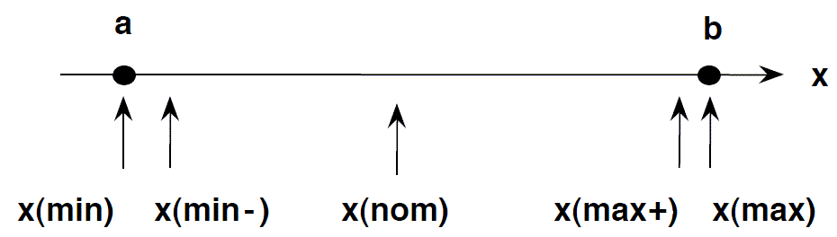
DYNAMIC TESTING TECHNIQUE
Boundary Value Analysis (BVA)
11

Slide 12
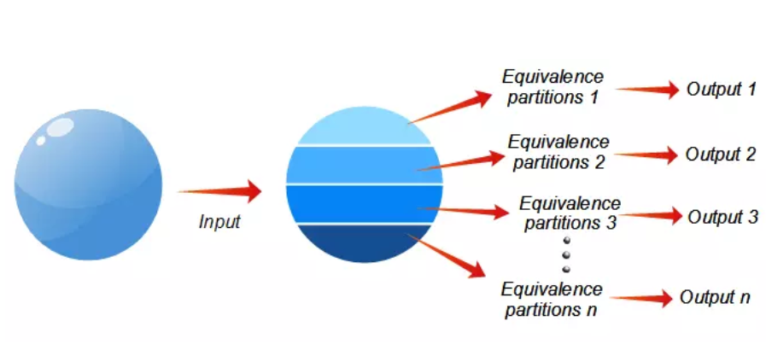
DYNAMIC TESTING TECHNIQUE
Equivalence Partitioning (EP)
12

Slide 13
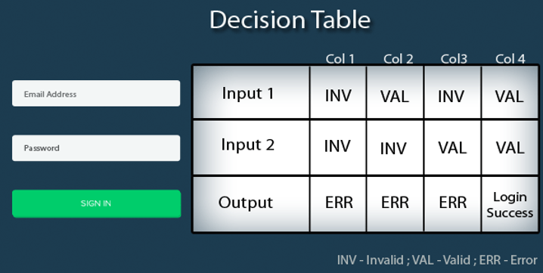
DYNAMIC TESTING TECHNIQUE
Decision Table Testing
13

Slide 14
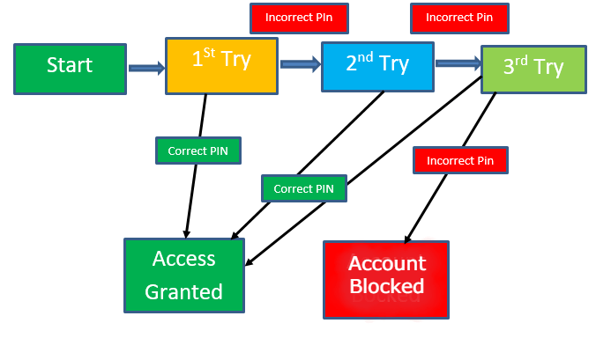
DYNAMIC TESTING TECHNIQUE
State Transition Diagrams
14

Slide 15



DYNAMIC TESTING TECHNIQUE
Error guessing
15

Slide 16
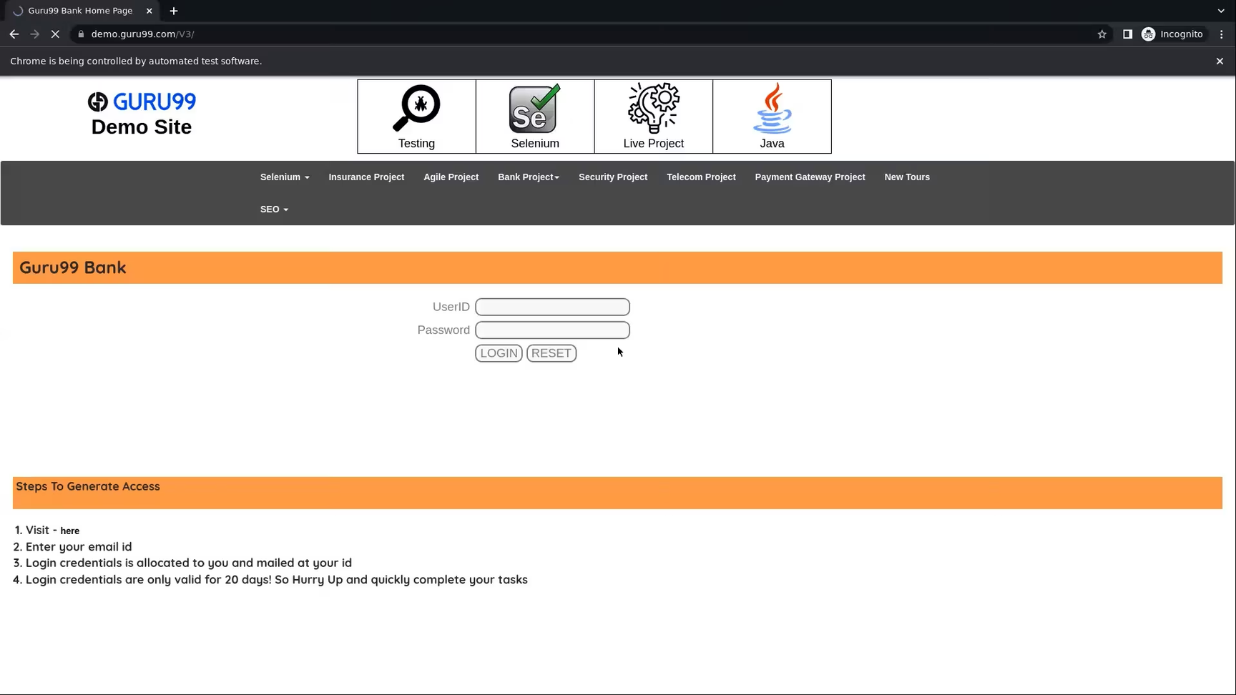
WEBSITE DEMO GURU99 BANK
16

Slide 17
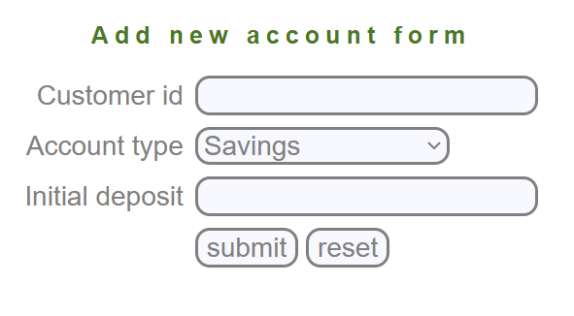
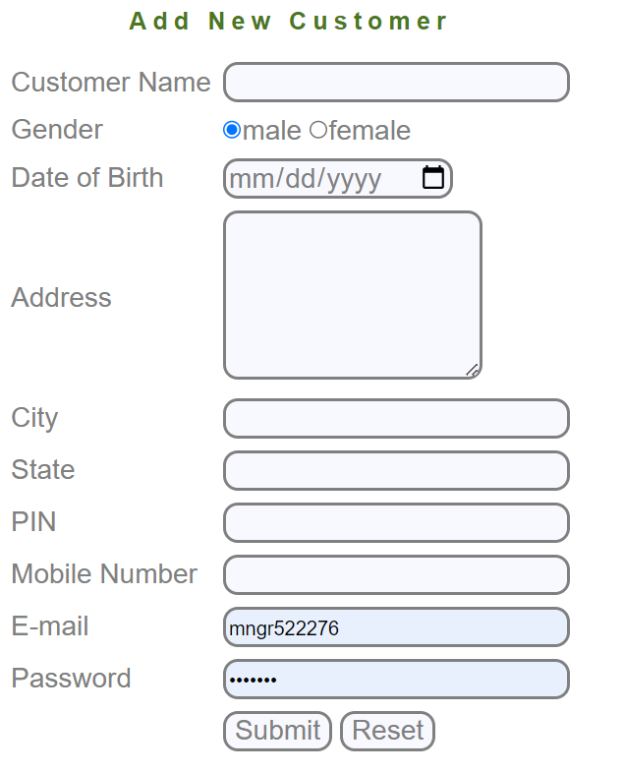
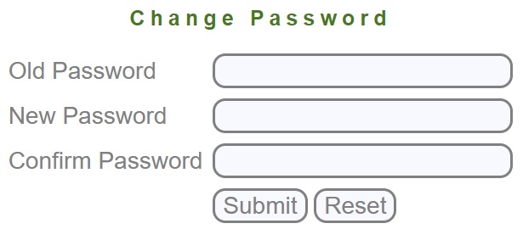
17

Slide 18
DEMO & RESULTS
18

Slide 19

19

Slide 20
THANK FOR LISTENING
20

